Slide 1





Predicting Alzheimer's Disease with Machine Learning
Project 4 - Team 1:
Riley Hutchinson, Quinn Jones, Jim Cockerham, Katrina Rodriguez,

Slide 2
Project Outline
Project Proposal
Data Analysis
Machine Model Learning
Considerations
Summary

Slide 3
Project Proposal
The aim of our project is to assess the predictability of Alzheimer's disease diagnosis, enabling early intervention strategies. We will analyze the relationship between patient demographic information, lifestyle factors, and medical information to identify trends in positive diagnoses using binary prediction models.

Slide 4


Data Analysis
Pre-Processing and Visualization of the dataset

Slide 5
The questions we used to create our data analysis, visualizations, and models:
Can we create a model to predict an Alzheimer's diagnosis with 90% or more accuracy?
What features are most impactful for increased accuracy?
What features were least relevant to the model's accuracy?
What is the best type of model to optimize accuracy?
What other information or dataset would be impactful to the learning model?

Slide 6








Machine Model Learning
Finding the right model to optimize accuracy.

Slide 7
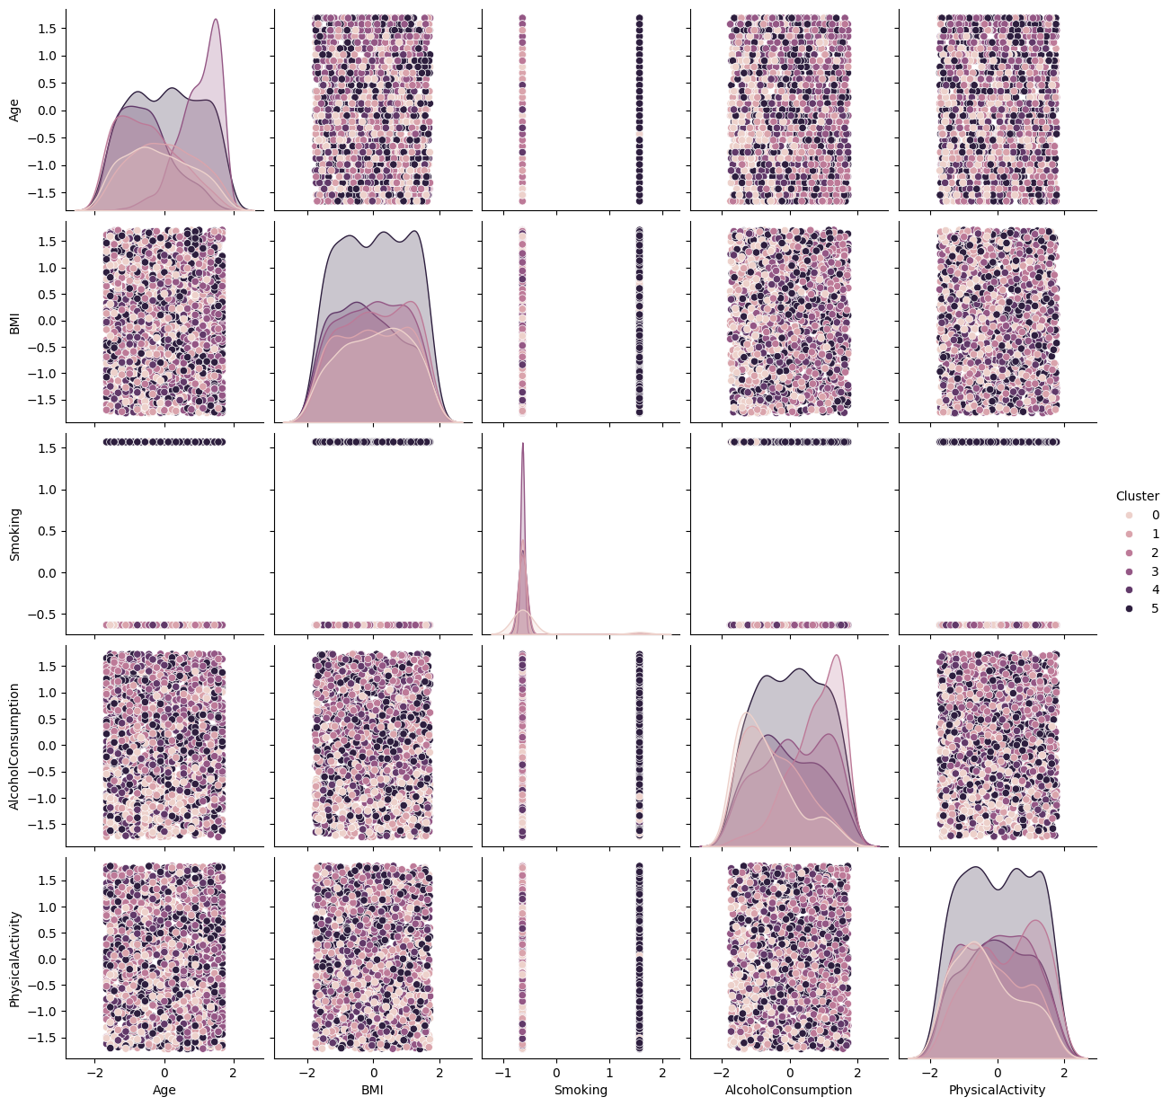
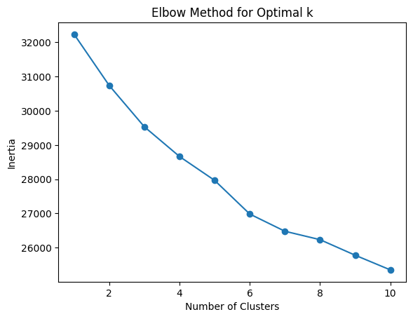
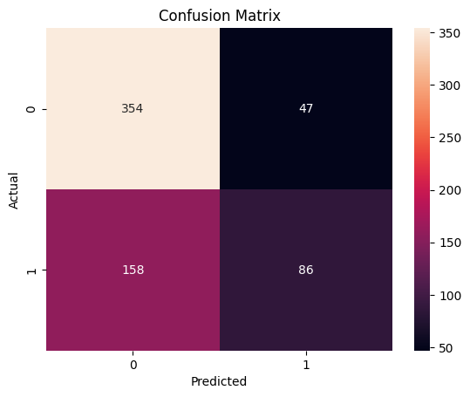
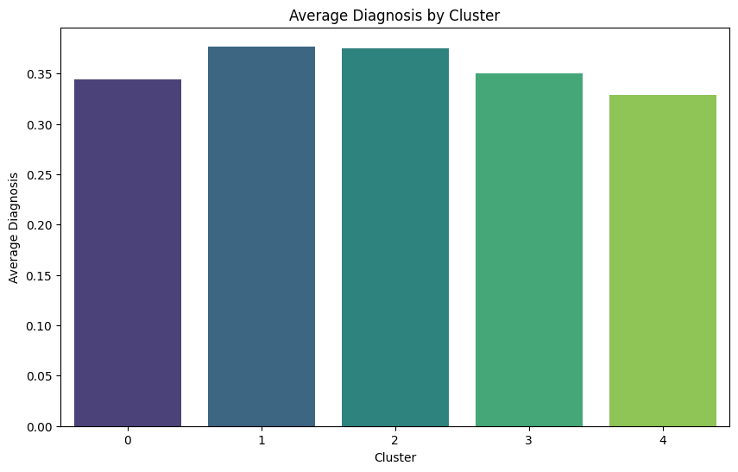
Random Forest Clusters
The clustering analysis helps identify patterns and group similar patients.
The Random Forest model provides a reliable prediction of Alzheimer's diagnosis.
Feature importance analysis highlights the most influential factors in the prediction.

Slide 8
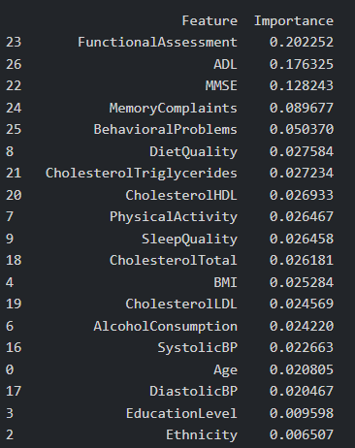
Key Features
In our initial Random Forest model, a data frame was created to rank feature importance used in the accuracy results.

Slide 9

Refining the Data
Would dropping the cognitive assessment features from the model impact the accuracy results?
Notes:
After going over our features and their importance we found that there's a 4% drop in importance after the top 3 features (Functional Assessment, ADL, and MMSE). This presents a practical challenge - as these 3 features are all medically diagnosed assessments that a person typically receive only when they're ALREADY consulting with a doctor about Alzheimer's.
This caused us to question our model's real-world utility: If someone is already undergoing these specialized assessments, would they actually need our model? We then decided to test whether our model could maintain its accuracy without relying on these 3 clinically-obtained features.

Slide 10
Neural Network Feature Selection
Our goal was to assess the impact of MMSE, ADL, and Functional assessment on model accuracy. By removing and reintroducing these features, we aimed to determine their significance and whether their exclusion would improve or hinder predictive performance.
MMSE (Mini-Mental State Examination)
ADL (Activities of Daily Living)
Functional Assessment
Notes:
To test this, we began by completely removing all 3of the cognitive assessment features from our model.
Then, we reintroduced them to measure their impact on our model's accuracy.
This allowed us to determine whether removing these features would absolutely tank the accuracy of our model, have a negligible effect, or potentially - though less likely - if removing them might actually improve our accuracy.
ADL: Activities of daily Living score. 0-10 lower == greater impairment
MMSE: Mini-Mental State Examination score. 0-30 lower == cognitive impairment
Functional Assessment: Score 0-10. Lower == More physical impairment

Slide 11
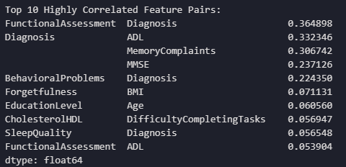
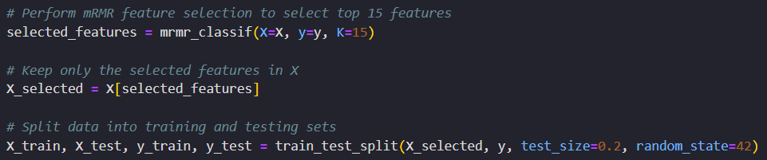
Model Optimization: mRMR
mRMR (Minimum Redundancy Maximum Relevance)
Selects the best features for machine learning by:
Choosing features that strongly predict the target (maximum relevance)
Avoiding features that are too similar/repetitive (min redundancy)
It does this by calculating a correlation matrix
Choose the selected number of features to build your model with
Notes:
To start our model, we used an algorithm called mRMR, which stands for Minimum Redundancy Maximum Relevance. This feature selection algorithm identifies features that most strongly predict our target feature (Diagnosis) while simultaneously weeding out features that were deemed more redundant. The advantages of this are twofold: it significantly reduces the amount of time our computers spent running and helps prevent overfitting in our model by eliminating repetitive data.
One of the key strengths of the mRMR algorithm is that it allows us to control how many features pass through to our final model, allowing us to fine-tune the balance between predictive power and simplicity. Giving us the biggest bang-for-our-buck.
mRMR then feeds the strongest features into our model which Quinn will now talk about…

Slide 12
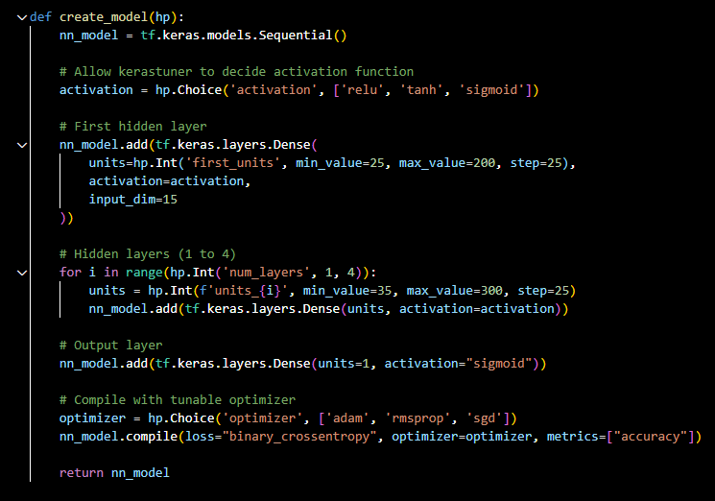
Model Optimization: Keras
Keras Tuner optimized our neural network by testing various architectures and hyperparameters, identifying an efficient model structure. This improved prediction accuracy while keeping the design streamlined for effective training.

Slide 13
Optimization Results
Removing both the MMSE and ADL columns lowered accuracy, confirming their importance. Including both increased accuracy to 77.4%, while keeping all features resulted in the highest accuracy at 84.9%. These findings highlight the necessity of both MMSE and ADL in optimizing model performance.

Slide 14
Considerations
Additional Data:
Our model could potentially be improved by grabbing additional data related to alzheimer's disease. For example, we could include features related to genetics, lifestyle, and even expand into imaged-based machine learning.
Lifestyle Features
Patient interaction data
Hobbies
Social Engagement
Hearing Loss
Imaging-based Features
Structural MRI Measures
White matter lesions
EEG / MEG (Magnetoencephalography)
Functional MRI (fMRI)
Notes:
Structural MRI: Measures the shrinkage of specific brain regions
White matter Lesions: Areas of damage to the white matter, they appear as bright spots
EEG/MEG: Alzheimer's can alter the brain’s electrical rhythms. EEG/MEG can detect slowing of brain waves and changes in their complexity
fMRI: Detects changes in blood flow in the brain, which is used to measure brain activity

Slide 15
Summary Conclusion
The Mini-Mental State Examination Score, Activities of Daily Living Score, and Functional Assessment contributed to higher accuracy results.
To optimize accuracy of the model, Keras Tuner and MRMR helped identify and streamline features and model design that could be impactful.
We were able to achieve 85% accuracy with the cognitive assessments, and around 68-74% accuracy without.
Additional information like genetic data or specific lifestyle factors should be considered as other additional features to increase accuracy.

Slide 16
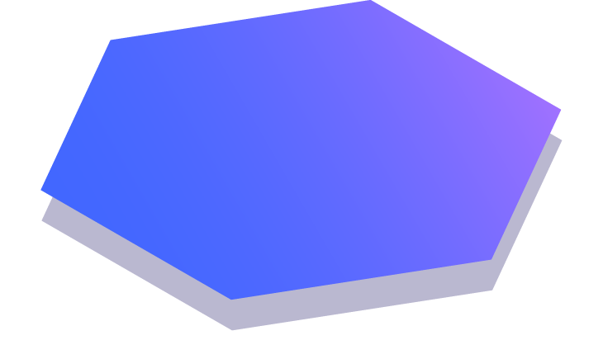
Questions?

